Slide 1
Pointers – continued
Mohammad Salman

Slide 2
#include<iostream>
int main()
{ int x{ 5 };
int* ptr{ &x };
if (true)
{ int y{ 6 };
ptr = &y;
}
std::cout << *ptr << '\n’;
return 0; }
int x
5
0x10

Slide 3
#include<iostream>
int main()
{ int x{ 5 };
int* ptr{ &x };
if (true)
{ int y{ 6 };
ptr = &y;
}
std::cout << *ptr << '\n’;
return 0; }
int* ptr
int x
0x10
5
0x40
0x10

Slide 4
#include<iostream>
int main()
{ int x{ 5 };
int* ptr{ &x };
if (true)
{ int y{ 6 };
ptr = &y;
}
std::cout << *ptr << '\n’;
return 0; }
int* ptr
int x
0x10
5
0x40
0x10
int y
6
0x18

Slide 5
#include<iostream>
int main()
{ int x{ 5 };
int* ptr{ &x };
if (true)
{ int y{ 6 };
ptr = &y;
}
std::cout << *ptr << '\n’;
return 0; }
int* ptr
int x
0x18
5
0x40
0x10
int y
6
0x18

Slide 6
#include<iostream>
int main()
{ int x{ 5 };
int* ptr{ &x };
if (true)
{ int y{ 6 };
ptr = &y;
}
std::cout << *ptr << '\n’;
return 0; }
int* ptr
int x
0x18
5
0x40
0x10
int y
What will be the output of this line?
6
0x18
Terminal> ???

Slide 7
#include<iostream>
int main()
{ int x{ 5 };
int* ptr{ &x };
if (true)
{ int y{ 6 };
ptr = &y;
}
std::cout << *ptr << '\n’;
return 0; }
int* ptr
int x
0x18
5
0x40
0x10
int y
Variable y goes out of scope here…
6
0x18
Terminal> ???

Slide 8
#include<iostream>
int main()
{ int x{ 5 };
int* ptr{ &x };
if (true)
{ int y{ 6 };
ptr = &y;
}
std::cout << *ptr << '\n’;
return 0; }
int* ptr
int x
0x18
5
0x40
0x10
?
We don’t know what is in this memory address now.
It’s no longer in our possession.
?
0x18
Terminal> ???
Notes:
Note that the memory address is still there, but the OS can now use it for anything else.
We have lost the rights to use it.

Slide 9
#include<iostream>
int main()
{ int x{ 5 };
int* ptr{ &x };
if (true)
{ int y{ 6 };
ptr = &y;
}
std::cout << *ptr << '\n’;
return 0; }
int* ptr
int x
0x18
5
0x40
0x10
?
Pointer, ptr, is left DANGLING, i.e. it’s not pointing to a valid memory address.
?
0x18
Terminal> ???

Slide 10
#include<iostream>
int main()
{ int x{ 5 };
int* ptr{ &x };
if (true)
{ int y{ 6 };
ptr = &y;
}
std::cout << *ptr << '\n’;
return 0; }
int* ptr
int x
0x18
5
0x40
0x10
?
You get undefined behavior if you try to dereference it.
?
0x18
Terminal> UNDEFINED BEHAVIOR
Notes:
In some cases, it may actually print value of y, but may lead to an error as well.
Runtime error (not compile time).

Slide 11
#include<iostream>
int main()
{ int x{ 5 };
int* ptr{ &x };
if (true)
{ int y{ 6 };
ptr = &y;
}
ptr = nullptr;
return 0; }
int* ptr
int x
0x0
5
0x40
0x10
?
Set dangling pointers to null, i.e. they are pointing nowhere.
?
0x18
Terminal> Nice!

Slide 12
Can you think of a possible sequel to this story?
#include<iostream>
int main()
{ int x{ 5 };
int* ptr{ &x };
if (true)
{ int y{ 6 };
ptr = &y;
}
ptr = nullptr;
return 0; }
int* ptr
int x
0x0
5
The story actually hasn’t ended yet…
0x40
0x10
?
Set dangling pointers to null, i.e. they are pointing nowhere.
?
0x18
Terminal> Nice!

Slide 13
#include<iostream>
int main()
{ int x{ 5 };
int* ptr{ &x };
if (true)
{ int y{ 6 };
ptr = &y;
}
ptr = nullptr;
std::cout << *ptr << '\n';
return 0; }
int* ptr
int x
0x0
5
0x40
0x10
?
What will happen on dereferencing ptr while it’s pointing nowhere?
?
0x18
Terminal> ???

Slide 14
#include<iostream>
int main()
{ int x{ 5 };
int* ptr{ &x };
if (true)
{ int y{ 6 };
ptr = &y;
}
ptr = nullptr;
std::cout << *ptr << '\n';
return 0; }
int* ptr
int x
0x0
5
0x40
0x10
?
This will also be UNDEFINED BEHAVIOR.
?
0x18
Terminal> UNDEFINED BEHAVIOR (Mostly likely a program crash).
Notes:
Again, this is a runtime error (not a compile time error).

Slide 15
#include<iostream>
int main()
{ int x{ 5 };
int* ptr{ &x };
if (true)
{ int y{ 6 };
ptr = &y;
}
ptr = nullptr;
std::cout << *ptr << '\n';
return 0; }
int* ptr
int x
0x0
5
0x40
0x10
Any workarounds?
?
This will also be UNDEFINED BEHAVIOR.
?
0x18
Terminal> UNDEFINED BEHAVIOR (Mostly likely a program crash).

Slide 16
#include<iostream>
int main()
{ int x{ 5 };
int* ptr{ &x };
if (true)
{ int y{ 6 };
ptr = &y;
}
ptr = nullptr;
if (ptr == nullptr)
std::cout << "ptr is null\n";
else
std::cout << *ptr << '\n’;
return 0; }
int* ptr
int x
0x0
5
0x40
0x10
?
Check for null pointers…
?
0x18
Terminal> ptr is null
// Program didn’t crash…
Notes:
Skipped the braces due to lack of space on the slide.

Slide 17
#include<iostream>
int main()
{ int x{ 5 };
int* ptr{ &x };
if (true)
{ int y{ 6 };
ptr = &y;
}
ptr = nullptr;
if (ptr == nullptr)
std::cout << "ptr is null\n";
else
std::cout << *ptr << '\n’;
return 0; }
int* ptr
int x
0x0
5
0x40
0x10
The End
?
Check for null pointers…
?
0x18
Terminal> ptr is null
// Program didn’t crash…
Notes:
Skipped the braces due to lack of space on the slide.

Slide 18
Dangling Pointers
Your pointers should point to valid entities.
Or they should be set to null.
So now, only check for null pointers before working with them…
… And any non-null pointers can be assume to be valid.

Slide 19
Some Situations to be Mindful of…
Some situations where pointers may be left dangling.
Returning pointers from functions.
If they’re pointing to local variables, those local variables have gone out of scope.
Something similar to the example discussed in this lecture.
When working with dynamic memory (coming soon…).

Slide 20
Dangling Pointers
The code used in this example is also available in the relevant code file.
6-pointers_dangling.cpp
I have used an if block, but you can just create a regular code block as well.

Slide 21
Self-Reading
Following slides contain some useful screenshots relevant to the topic of null pointers and dangling pointers.
These screenshots have been taken from the following link.
https://www.learncpp.com/cpp-tutorial/null-pointers/

Slide 22
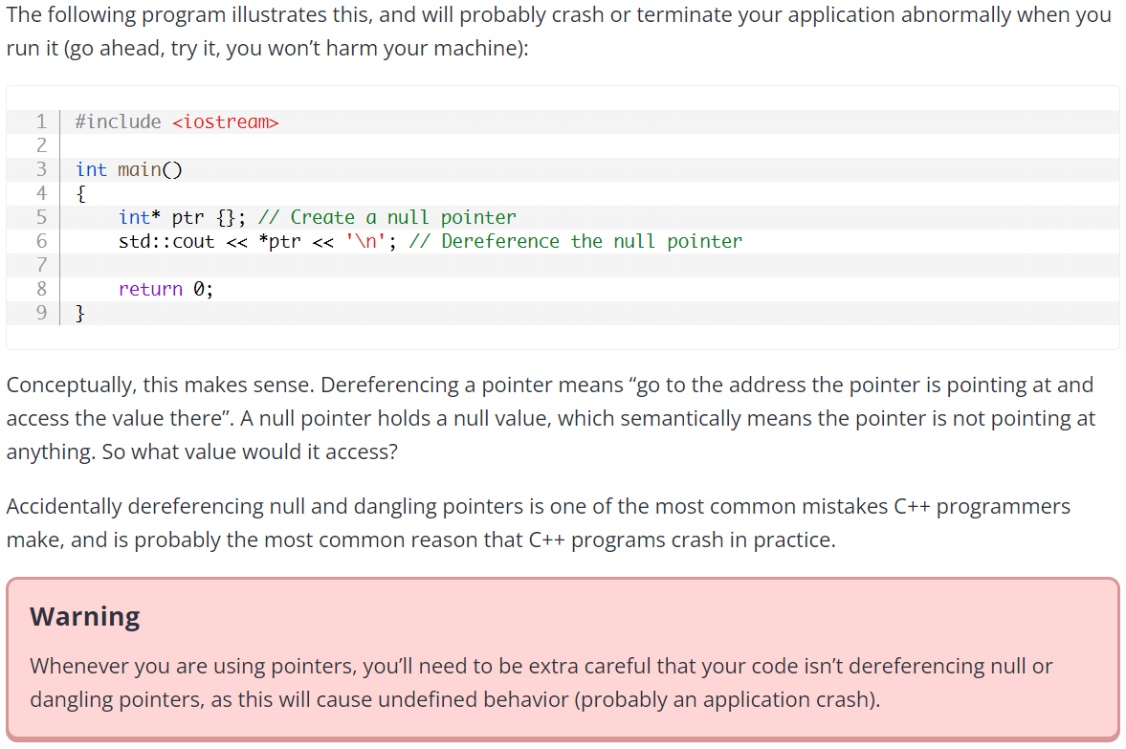
Another explanation about why dereferencing null pointers doesn’t make any sense.

Slide 23
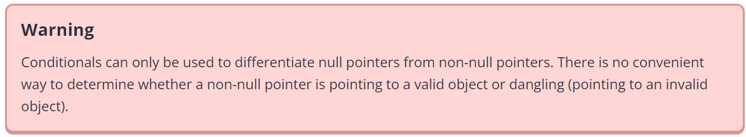

Slide 24
